Slide 1
PS 121 – Fifth Grade
Please sign the attendance sheet using the link in the chat.
Notes:
‹#›

Slide 2
Agenda
Welcome to 5th Grade
What will your students be learning?
5th Grade Policies
5th Grade Curriculum Overview
New York Fifth Grade Tests
Conferences and Resources
Senior Fun!
What role can you play?
How can we help?
Notes:
‹#›

Slide 3
5TH GRADE TEACHERS
Mr. Cifarelli- Class 501, Room 516- pcifarelli@PS121Q.com
Mrs.Zgalgic- Class 521, Room 508- ctobia@schools.nyc.gov
Ms. Calderon- Class 502, Room 511- rcalderon@PS121Q.com
Mrs. Lizza & Mrs. Luttenberger- Class 531, Room 514
jlizza@schools.nyc.gov kluttenberger@outlook.com
Ms.Chaplin- Class 591, Room 510 achaplin@PS121Q.com

Slide 4
Welcome to P.S. 121 Nicholas J. Patrello (Principal) Joshua Atlas & Lisa Brand (Assistant Principals)
Mission: We are committed in ensuring that every student is provided with the skill sets to achieve grade level expectations in a safe, diverse, nurturing, and supportive environment that takes into account each child’s unique learning needs and fosters creativity, accountability, and a sense of community in order for them to become successful lifelong learners.
Instructional Focus: We will strengthen core instruction through the development of units of study that address different levels of students thinking. All learners will explore big ideas in content-rich texts and engage in meaningful discussion through the use of academic language and routines across all classrooms to produce skilled readers, writers and thinkers.
Extra Programs: Technology, Math, Art, Writing, Physical Education, Science, CLUBS and Dance
Notes:
‹#›

Slide 5
5th Grade Policies
Homework Policy
The students will be given homework every night
The homework will consist of both reading and math as well as either social studies or science
Homework should take approximately 30min-60min
If your child is taking longer than that please let your teacher know
You may want to check agendas, Homework folders, and Google Classrooms
***Please know that missing HW or improper behavior may result in losing senior privileges***

Slide 6
Behavior Policy
Improper behavior inside the classroom (constant calling out, disrespect of teacher, hitting classmates, etc) may result in phone calls home, detentions, and/or suspensions
Students must also behave outside of the classroom
-With prep teachers, at lunch, on field trips, etc.
-Mr. Atlas is the Assistant Principal
✭Class Dojo
-Behavior program -Class Dojo

Slide 7
Cell Phone Policy
If your child must bring a cell phone it must be
Turned off
In their backpacks
If a cell phone rings during class or is found on your child during the school day it will be confiscated and the parent will be notified to pick up the cell phone
If you must reach your child you may call the school secretary
All students and parents need to read and sign the DOE cell phone policy

Slide 8
Next Generation Learning Standards
Prepare students with the knowledge and skills they need to succeed in college and work (lifelong learning)
Provide educators, parents, and students with clear and focused standards or guideposts
Set consistent expectation
Include both knowledge and the application of subject area
Are based on real-world application for 21st century life
Are evidence and research-based, with guidance on topics to include, when to introduce content, and coherence/focus to the individual needs of the students in their classrooms.
http://www.nysed.gov/common/nysed/files/parentbrochurenextgen.pdf (Parent Brochure)

Slide 9
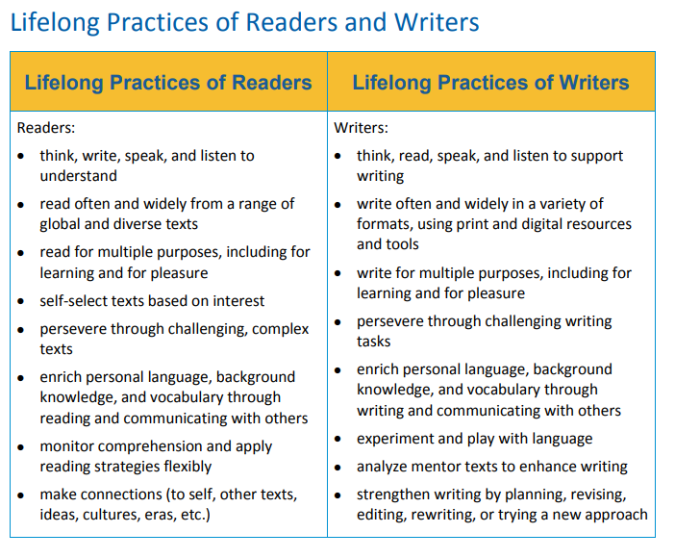
New York State Next Generation English Language Arts Learning Standards
NYS Next Generation Learning Standards ELA

Slide 10
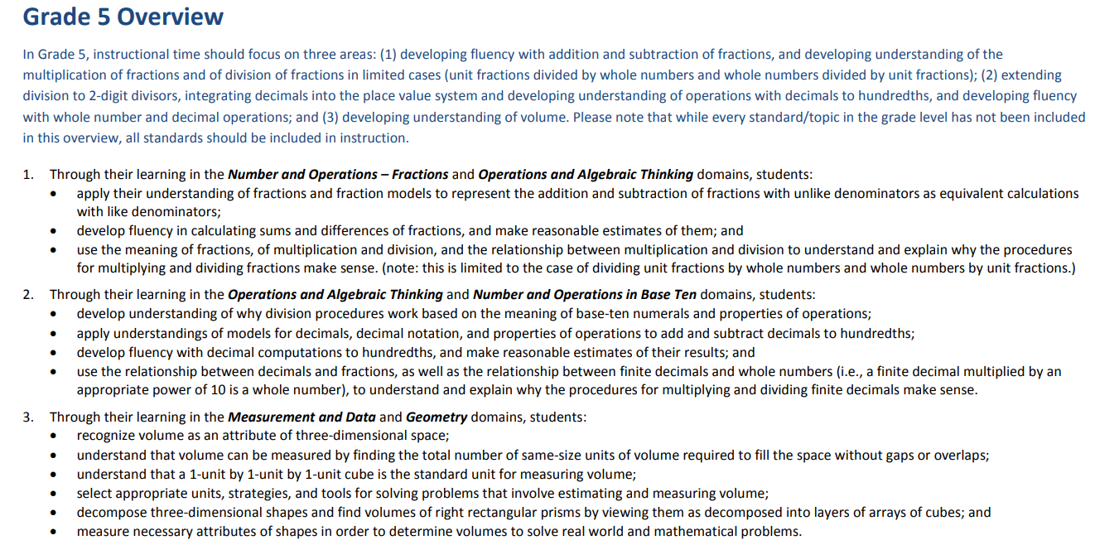
New York State Next Generation English Language Arts Learning Standards
NYS Next Generation Learning Standards Math

Slide 11
“I Can” Statements
Standards written in child friendly terms
Child must master these standards by the end of the school year to be on grade level
Displayed in the classroom based on unit we are currently studying
Child will have many opportunities practice the standard
Students will acknowledge when they
have successfully mastered a standard

Slide 12
What will the students be learning in Literacy?
Reading:
Reading program called Into Reading
Aligned to Next Generation Standards
Focus on improving their reading comprehension, fluency, and vocabulary
Writing:
Persuasive Writing, Narrative Writing, Expository Writing, Opinion Writing,Poetry, Informational Writing
Your student will use editing techniques and computer programs to better their writing
There is a large emphasis on vocabulary this year – it will make your child a better reader
Notes:
‹#›

Slide 13
Ways to Prepare for ELA Over the Summer
Students should be reading daily and practicing reading strategies over the summer.
Read books that you enjoy…this should include Informational and Literary Texts.
Continue to check in with your child by having discussions about what they are reading and learning!

Slide 14
What will the students be learning in Mathematics?
How do we see mathematics in our everyday lives? In our future job choices?
Place value, exponents, decimals, fractions, PEMDAS, geometry, measurement, division, multiplication, percents, conversions, etc.
Students will be prepared for the upcoming math assessment based on practice exams and math strategies taught in class.
enVision Math
Students must know basic math skills (such as their times tables) and review classroom notes daily
Notes:
‹#›

Slide 15
Ways to Prepare for Math Over the Summer
Practice your multiplication facts
Continue to log into iReady
Have your child work on math problems and explain solutions verbally and/or in a written format using Math vocabulary.
Practice solving solutions in more than one way (i.e. pictures, numbers, words)

Slide 16
What will the students be learning in Social Studies?
Social Studies- Passport
Geography, European Exploration, Western Hemisphere today, United States, Dominican Republic, Canada, and Mexico
Notes:
‹#›

Slide 17
What will the students be learning in Science?
Science- Amplify
Patterns of Earth and Sky, Modeling Matter, The Earth System, Ecosystem Restoration
Notes:
‹#›

Slide 18
New York State Exams
NY ELA Exam
April 11-12, 2024
NY Mathematics Exam
May 7 – 8, 2024
*** Attendance is very important on these dates as well for dates scheduled for practice exams ***
Notes:
‹#›

Slide 19
Teacher-Parent Communication
Parent teacher Conferences (Virtual)
November
March
May
Parent Engagement (NEW TIMES):
Parents may set up an appointment with their child’s teacher to discuss any questions and/or concerns
Appointments/ Phone Conversations can be scheduled during the week Monday- Friday

Slide 20
Student-Led Conferences
For the months of November and March, we will be scheduling appointments with parents and your child.
Your child will lead these conferences by showcasing all of their hard work and discussing their grades and progress.

Slide 21
Helpful Websites
NewsELA
Readworks
epic
myon
iReady
Prodigy
Dreamscape
NatGeokids
Flocabulary
Each teacher’s Google classroom will have a section with helpful resources!

Slide 22
Social Emotional Learning (SEL)
SEL Read Alouds
Morning Meeting (Review Daily Schedule)
EPIC Reading Breakings
Independent Reading Time

Slide 23
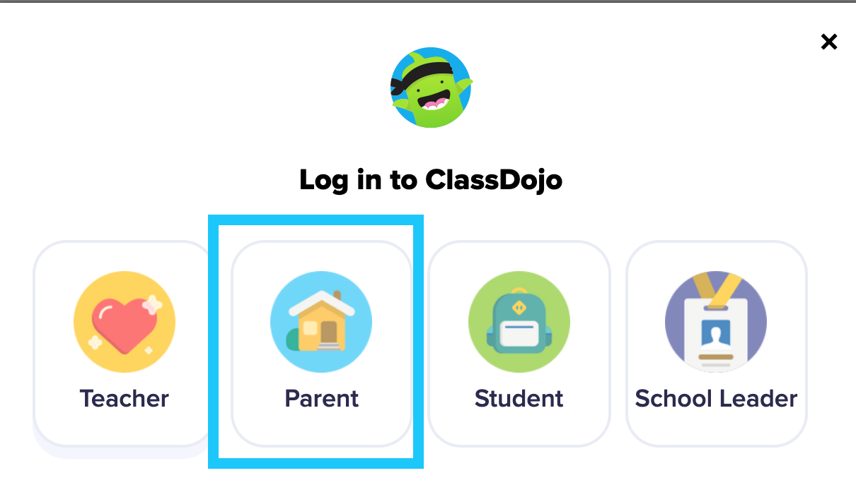
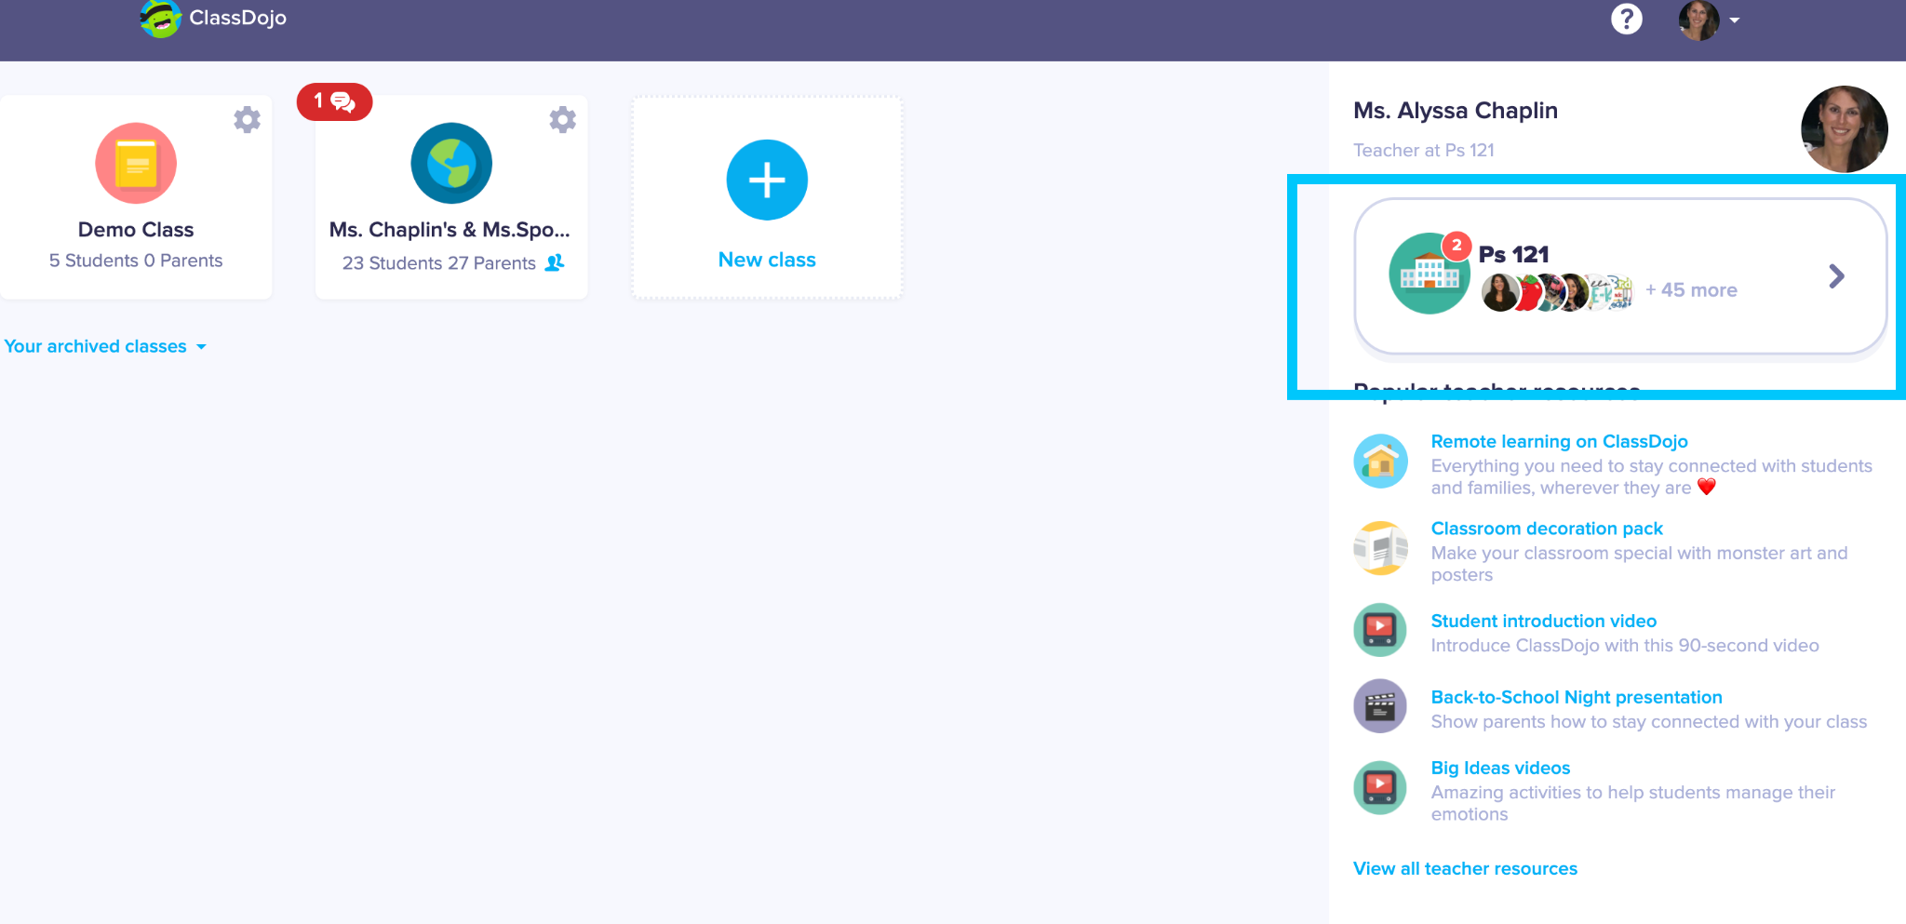
Class Dojo
Please make sure you are checking Class Dojo each day for important reminders and announcements from your child’s teacher.
Check the PS121 School Story for information and announcements!

Slide 24
Being a Senior!
This will be your child’s last year at PS121!
Your child can look forward to…a fun-filled dance, a senior trip, classroom achievement awards, 2023 Yearbook, Senior Memorabilia Package and an outstanding GRADUATION! (Details TBD)
CLUBS: A unique opportunity for 5th grade; Students choose a speciality to enjoy once a week (art, dance, STEM, technology, board games, digital art, etc)
Applying to Middle School
You will receive a middle school application later in the school year. Please return it by the date given.
If you have any questions or concerns please contact your classroom teacher or our school counselor Mrs. Ramdath.
You may want to attend Middle School Open House Meetings or go to that school’s websites to get more knowledge about their programs

Slide 25
What role can you play in your child’s education?
Parent-Teacher Association
Parent-Teacher Conferences
Nov.,March., May
Homework & Tests
Completing all homework and studying for classroom and state tests is an essential part of student’s success. Please make sure your student is completing all assignments and is preparing for the state assessments.
Notes:
‹#›

Slide 26
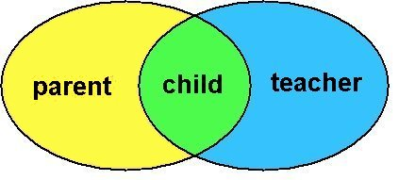
How can we help you and your child?
Please take this time to:
Ask any questions you may have?
Sign up for Class Dojo!
Briefly speak to your child’s classroom teacher to share questions/concerns

Slide 27
Thank You!
We look forward
to welcoming your child into 5th Grade!
Notes:
‹#›

