Slide 1
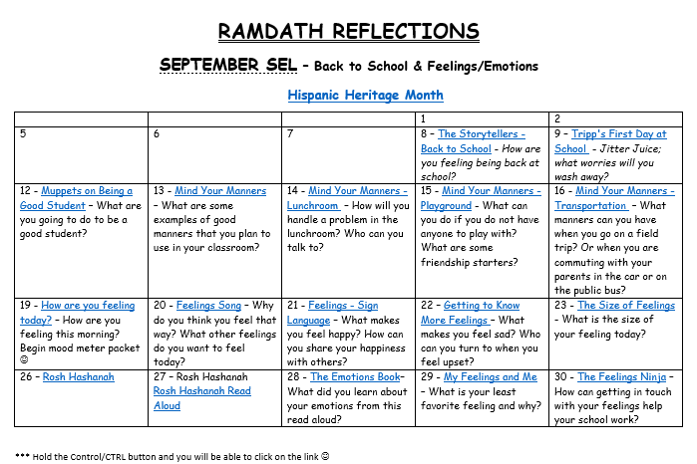
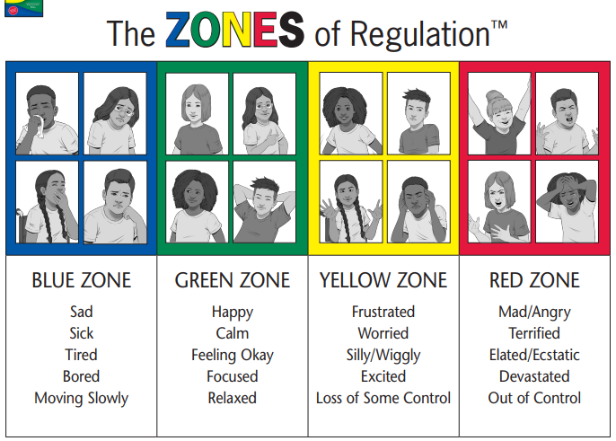
SEL SUPPORT FOR YOUR CHILD – 2023 & 2024
Mandated and At-Risk Students
An Advocate for All Students/Families
Classroom Guidance Lessons
Zones of Regulation
Middle School Guidance
Attendance Assistance
Community Resources and Referrals
SEL Monthly Themes
Daily videos/ discussion prompts
Parent Communication
Wednesday Wellness Lunch Breaks
Monthly SEL Newsletter
MRS. DOREEN RAMDATH – SCHOOL COUNSELOR – dramdath@schools.nyc.gov – 718-558-1560 ex 3141
MS. JACQLN ODLE – SCHOOL SOCIAL WORKER – jodle2@schools.nyc.gov – 718-556-1560 ex 2530

