Slide 1
PRE-K
BACK TO SCHOOL NIGHT
MS. NECEGA
MRS. POLLACK

Slide 2
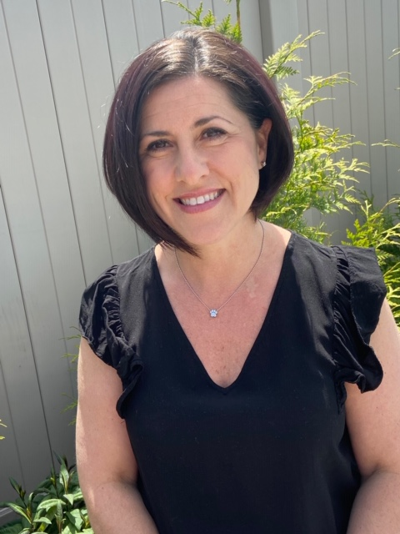
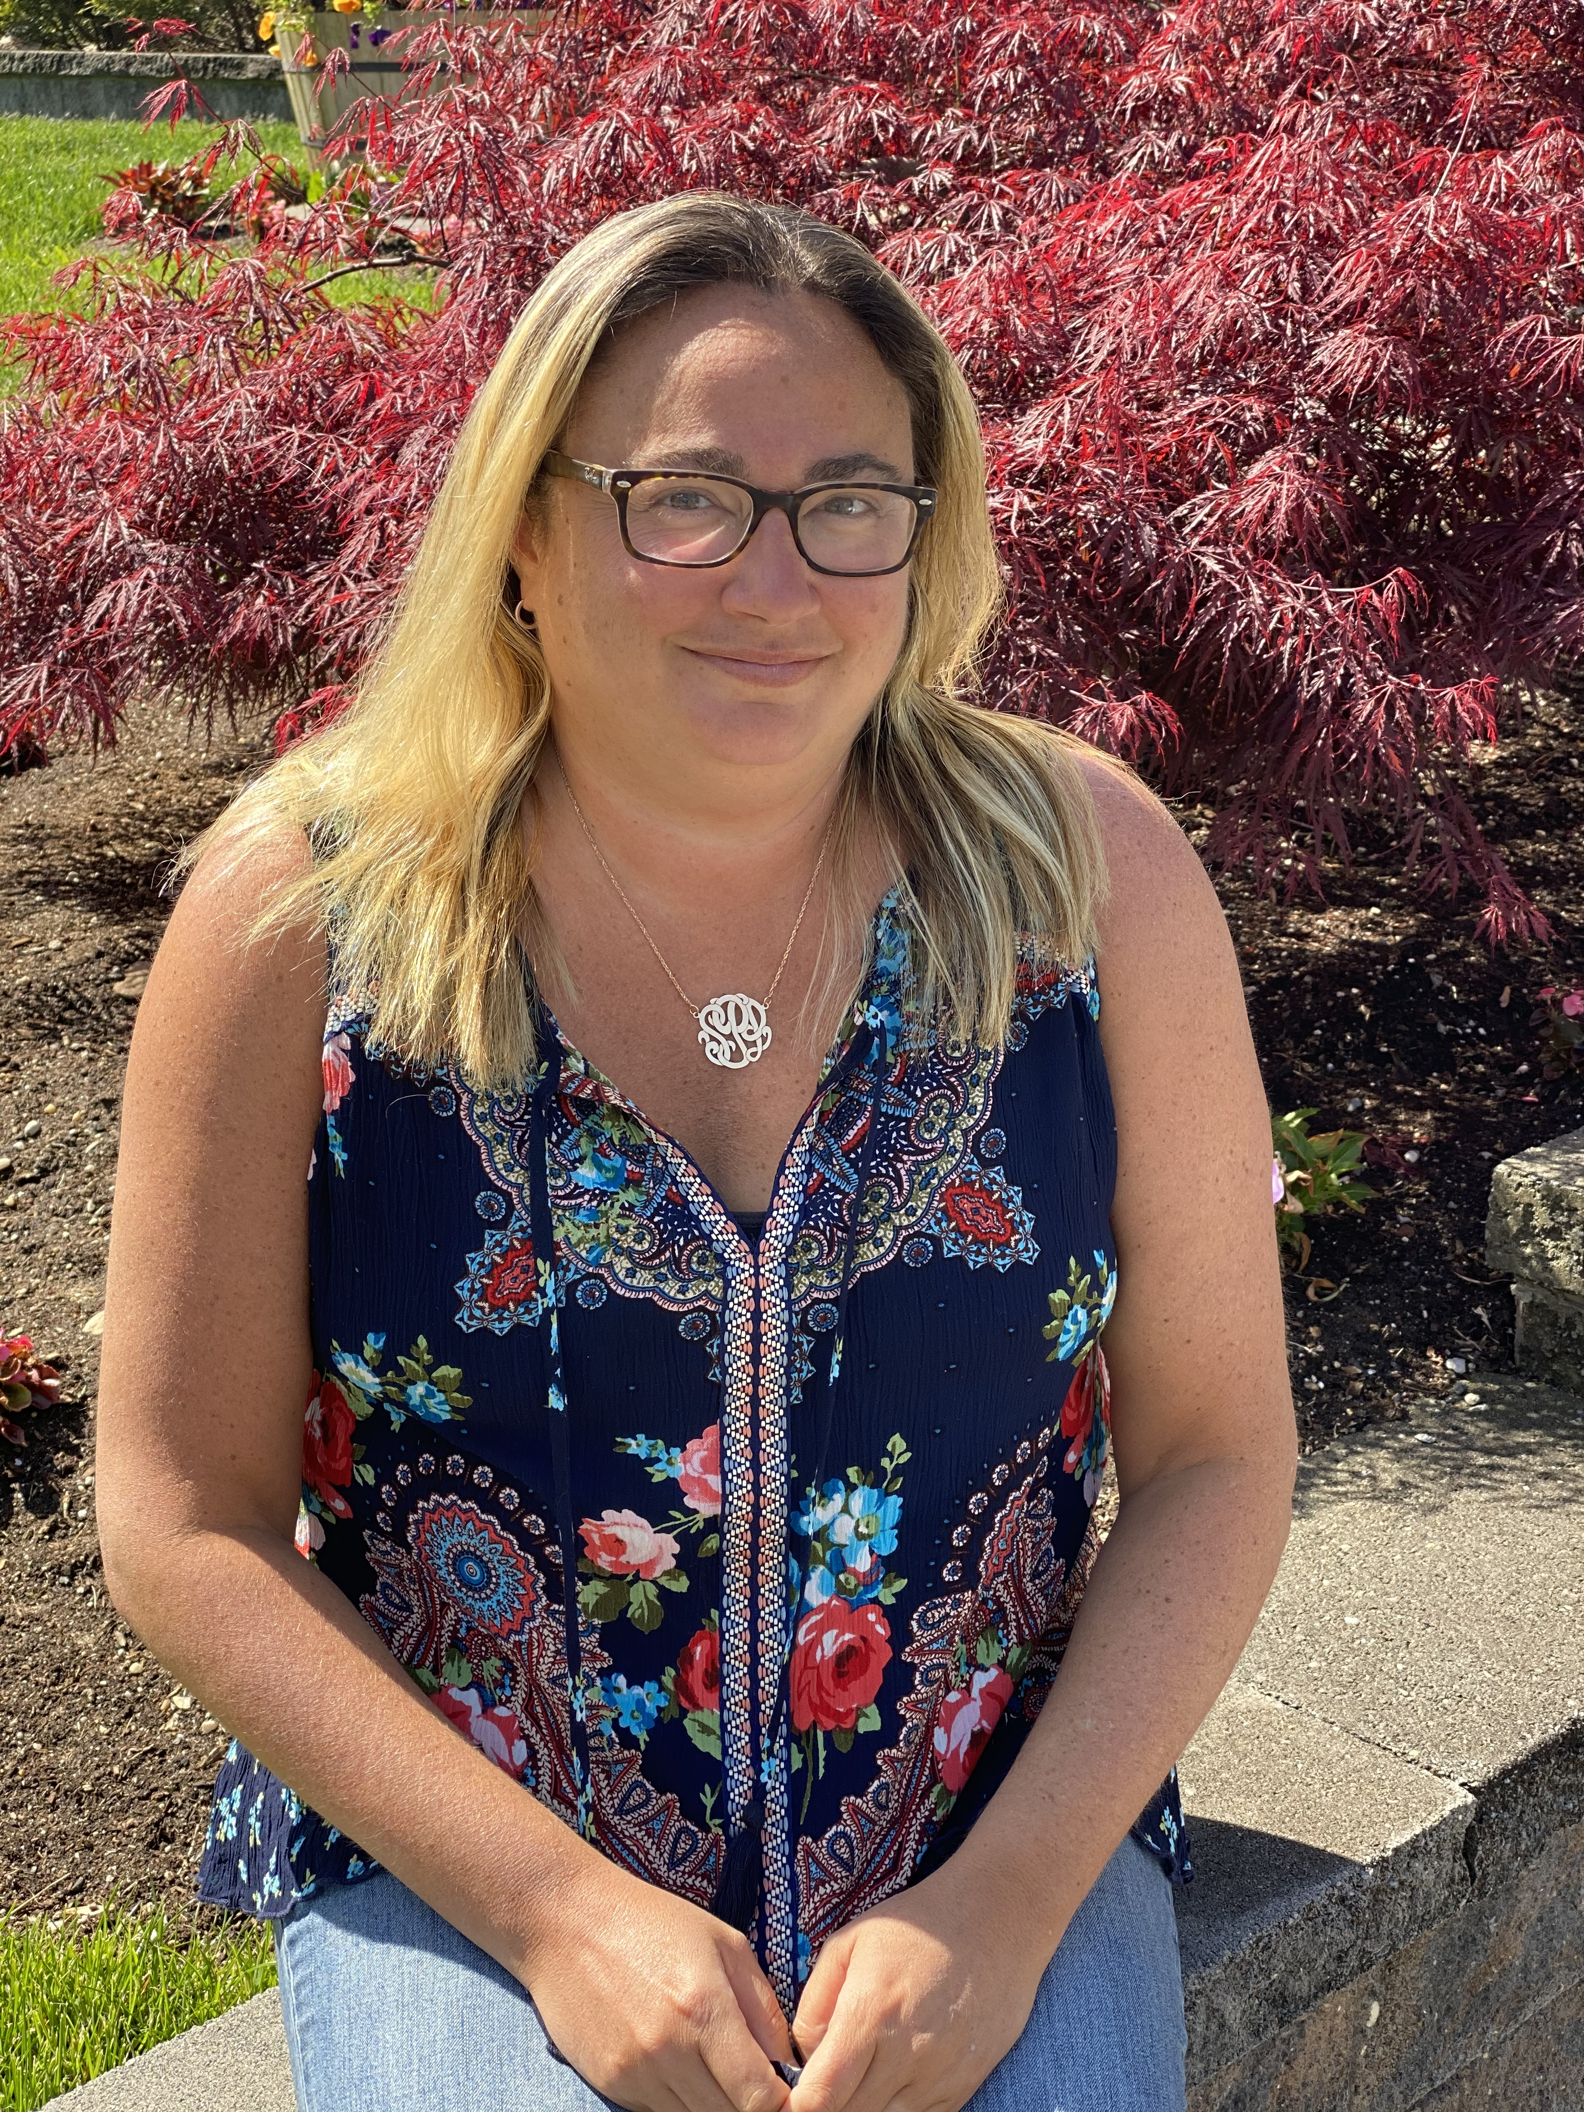
MRS. POLLACK
MS. NECEGA

Slide 3
WE REVIEW CLASSROOM RULES DAILY. PLEASE REMIND YOUR CHILD OF THE FOLLOWING:
KEEP THEIR HANDS TO
THEMSELVES
RAISE YOUR HAND
LISTENING TO THEIR TEACHERS

Slide 4
ARRIVAL/BREAKFAST
MORNING MEETING
GROSS MOTOR
(OUTDOOR) PLAY
CENTER ACTIVITIES
MUSIC/MOVEMENT
LUNCH
REST TIME
CENTER ACTIVITIES GROSS MOTOR
DISMISSAL

Slide 5
STUDENTS ARRIVE AT SCHOOL EACH MORNING AT 8:00 USING EXIT 2 (127 TH STREET)
PLEASE MAKE SURE YOU ARE ON TIME AS THE DOORS CLOSE BY 8:05.

Slide 6
Students will be dismissed from school each day at 1:50 pm from exit 2 (127th Street)
Please make sure to arrive
on time so dismissal can run smoothly for all grades.

Slide 7
Class Dojo is our main form of communication. We are able to share messages, pictures, and reminders so you can stay informed as to what is happening in our classroom!

Slide 8
By The End Of Pre-K We expect your child to:
Write their name
Recognize letters of the alphabet
Recognize numbers 1-10
Recognize basic shapes/colors

Slide 9
A complete extra set of clothes: shirt, pants, underwear, and socks. (Labeled in a Ziploc bag).
We accept donations of the following items:
boxes of tissues
paper towels
liquid hand soap,
hand sanitizer
zip lock bags (snack, sandwich, or gallon size)
copy paper
tubs of baby wipes
Lysol/Clorox Wipes

Slide 10
Backpack (Large enough to fit a folder)
Folder (with bottom pockets)
Water bottle
Sneakers
Slippers to keep in school

Slide 11
In Pre-k we will be using a new program called Creative Curriculum that covers all subject areas. Some of units include:
Welcome Friends
Balls
Buildings
Clothes
Exercise
Reduce, Recycle, Reuse
Trees
Water
Wheels

Slide 12
Center Based Learning
In Pre-k Children make decisions about where they will explore, discover, and learn each day. They learn independence by working by themselves or with other children during center/choice time activities. They read and write, build, cut, paint, and pretend. They practice planning, doing and reviewing what they did in centers. Building these skills is critical in a child’s social-emotional development. At Home Allow your child to make decisions about what to wear to school, which game to play, or which color towel to use. Ask your child to make a plan (e.g. decide what equipment they will play on in the playground or which games they want to play with a friend) and execute it. Then, help them reflect on how it went by talking about it with them and asking them how they think their plans went.

Slide 13
Students will eat breakfast each day in the classroom upon arrival. Even if your child eats at home, please make sure they arrive at school each day at 8:00 so we can walk up to the classroom together

Slide 14
Lunch will be provided daily, however you are welcome to send lunch in with your child if you prefer.
We encourage healthy eating so please only send lunch and a water bottle. (No snacks or juice please)
Please let us know of any allergies/dietary restrictions.

Slide 15
Our Pre-K students go outside for gross motor play each day.
Please make sure your child wears sneakers and is dressed appropritely for the weather.
As long as it is not raining or snowing we go outside.

Slide 16
There is NO formal homework in pre-k, although we will often send home suggested activities for you to do with your child that go along with what we are doing in school.

Slide 17
We Love to celebrate birthdays in school!
You are welcome to send in treats to share with the class on your child’s birthday!

Slide 18
We will be using an assessment called the ASQ. It is a parent questionnaire for you to fill out. We will be sending it home shortly and ask you to send it back in your child’s folder.

Slide 19
For any reason the school or classroom is closed (snow day, emergency) we will be utilizing google classroom and google meets.

Slide 20
Periodically we will be sending home book orders. We love to see children ordering books to have at home!

Slide 21
Sept 7 First Day of School (orientation) | Jan 15 Dr. Martin Luther King Jr. Day (schools closed)
Sept 8 Partial school day (1 hour) | Feb 19-23 Midwinter Recess (schools closed)
Sept 11 Partial School day (1.5 hours) | March 29-April 1 Easter Weekend (schools closed)
Sept 12 School from 8:00-10:30 | April 10 Eid al-Fitr (Schools closed)
Sept 13 First full day of pre-k | April 22-30 Spring Recess (schools closed)
Sept 25 Yom Kippur (schools closed) | May 27 Memorial Day (schools closed)
Oct 9 Italian Heritage Day (schools closed) | Jun 6 Anniversary Day Students do not attend school.
Nov 7 Election Day (schools closed) | Jun 7 June Clerical Day (Schools closed)
Nov 23–24 Thanksgiving Recess (schools closed) | June 17 Eid al-Adha (Schools closed)
Dec 25–Jan 1 Winter Recess (schools closed) | Jun 19 Juneteenth (schools closed)
 | Jun 26 Last Day For All Students
P.S.121 Pre-K Calendar

Slide 22
Do you have any questions for us?

