Slide 1
2nd Grade Teachers:
Ms. Lewis
Ms. Ruffino
Mrs. Gopaul
Mrs. Grossweiler
Ms. Dyal
Ms. Antoury
Mrs.Gopaul

Slide 2
Welcome to our virtual classroom!
Mrs.Gopaul

Slide 3
Welcome parents!
Mrs. Gopaul
Welcome parents to your classroom.
List the goals for the Curriculum Night:
To help parents understand the work students will be doing throughout the school year.
To explain your expectations for all students.
To share information about how parents can support student learning.

Slide 4
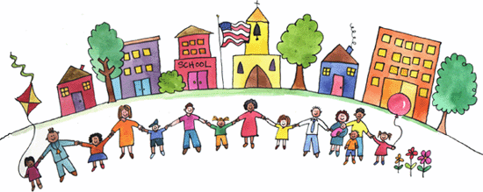
QUESTIONS Please save all questions until the end. Refrain from unmuting during the presentation.
Ms. Ruffino

Slide 5
Digital Classrooms
In the event of a school closure, class closure or asynchronous learning days, students will learn remotely. They will engage in instruction using the Google Classroom platform. It is important your child is connected to their Google Classroom. If you are having difficulty please contact your child’s teacher via dojo.
nycstudents.net email account to access Google Classroom
Ms. Ruffino

Slide 6
Class Dojo
Please check Class Dojo every day!
We send out important messages. It’s also a good way to stay in touch with the teacher about your child’s progress or concerns you may have.
Ms.Antoury
Please note teachers are only available for responses during school hours. Give 24-48 hours for a response. Contact the school office with any immediate concerns.
Public School 121 Q (718) 558-1560

Slide 7
Attendance
It is important that your child is at school each day and arrives on time (8:00 a.m.). It is disruptive to your child's education when he/she arrives late.
Please ensure your child enters through Exit 6 on 126th Street. They then proceed to the auditorium where we meet them each morning.
If your child will be absent, please let the teacher know in the morning via Class Dojo. If you know in advance that your child will not attend school, let the teacher know as soon as possible.
Ms. Antoury

Slide 8
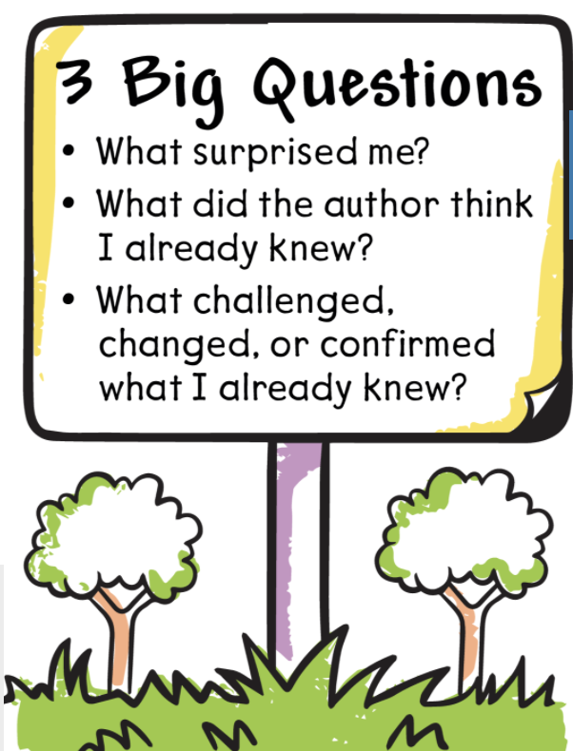
Reading Program: Into Reading Into Reading’s Workshop Model utilizes a gradual release of responsibility that sets students on a path to mastery and success. There are 12 Modules of Study. The first five modules: 1. Be a Super Citizen (Citizenship) 2. Look Around and Explore! (Discovering Our World) 3. Meet in the Middle (Solving Problems) 4. Once Upon a Time (Storytelling) 5. Lead the Way (Leadership)
Ms. Dyal

Slide 9
Reading Program: Into Reading During close reading, students identify and annotate literary elements, genre characteristics, and evidence of author’s purpose and craft. This analysis supports their own development as writers across multiple forms and genres. Key Skills:  Visualizing  Citing text evidence  Retelling  Summarizing Main Ideas/Key Details  Sequencing  Compare and Contrast  Ask and Answer Questions
Ms. Dyal

Slide 10
Reading
Close Reading:
Students will learn to:
Identify the gist/main idea
Annotate the text as they read
Provide a written response with text evidence – R.A.C.E.
Ms. Dyal

Slide 11
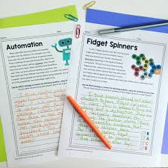
Writing
Some Genres We Will Explore this Year:
Personal Narrative Writing
Informational Writing
Persuasive Writing
Students will learn to draft, edit, revise with details, and publish their writing pieces.
Students will also learn the format for written responses – R.A.C.E.
Ms. Lewis

Slide 12
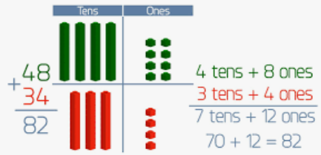
Mathematic Concepts
Number Concepts
Numbers to 1000
Basic Facts & Relationships
2-Digit Addition
2-Digit Subtraction
3-Digit Addition & Subtraction
Money & Time
Length in Customary Units
Length in Metric Units
Data - Graphs and Charts
Geometry & Fraction Concepts
Math Program: enVision Mathematics focuses on deep conceptual math understanding aided by visual models, and personalized learning.
Ms. Lewis

Slide 13
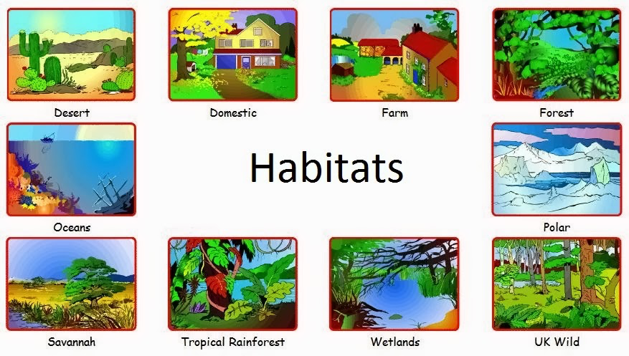
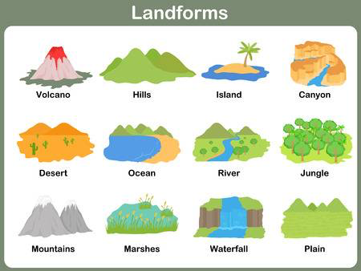
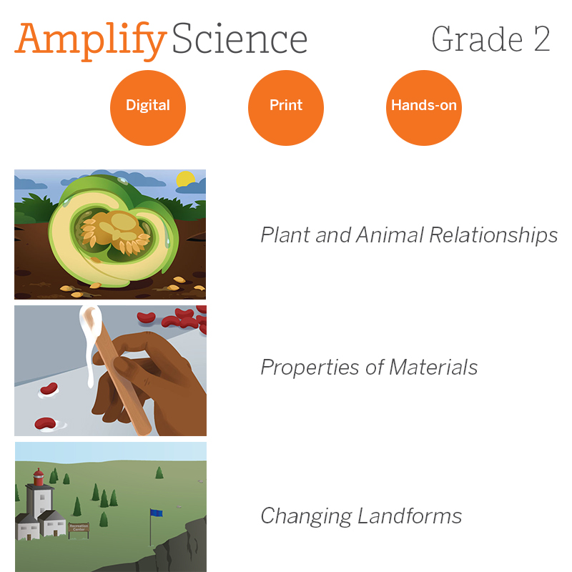
Amplify Science Units
Ms. Lewis
Plants and Animals Adaptions
Properties of Materials
Changing Landforms

Slide 14
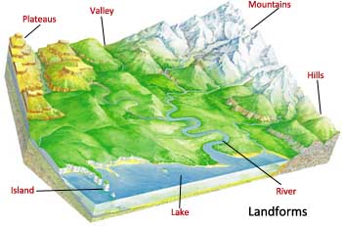
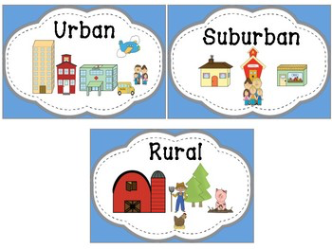
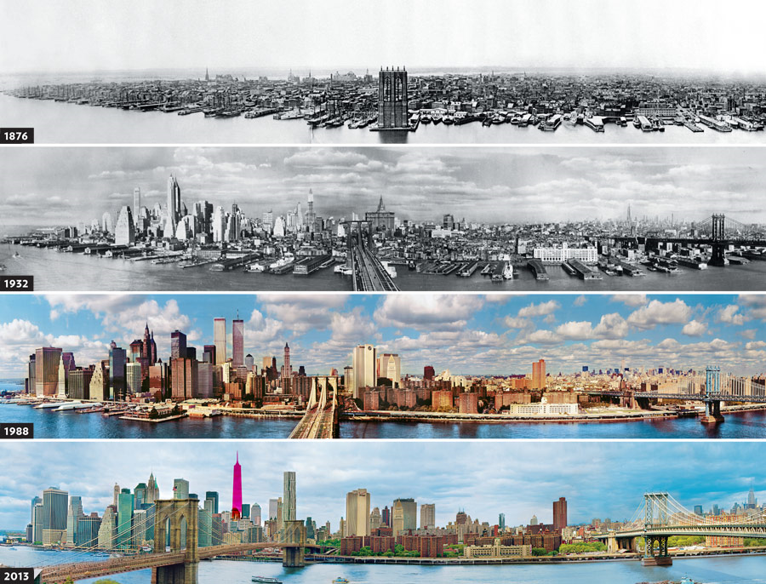
Passport to Social Studies
Units of Study
Our Community's Geography
New York City Over Time
Urban, Suburban, and Rural Communities
Rights, Rules, and Responsibilities
Mrs. Grossweiler

Slide 15
Homework
Homework is to be done every day and made up after an absence. Please feel free to sign their HW agenda/planner and Dojo the teacher if you have questions.
Please make sure that your child is doing the homework alone. If they are having trouble understanding the material, you can assist them with the assignment. If you feel they are struggling, send the teacher a Dojo to let her know that your child needs some extra help.
Mrs. Grossweiler

Slide 16
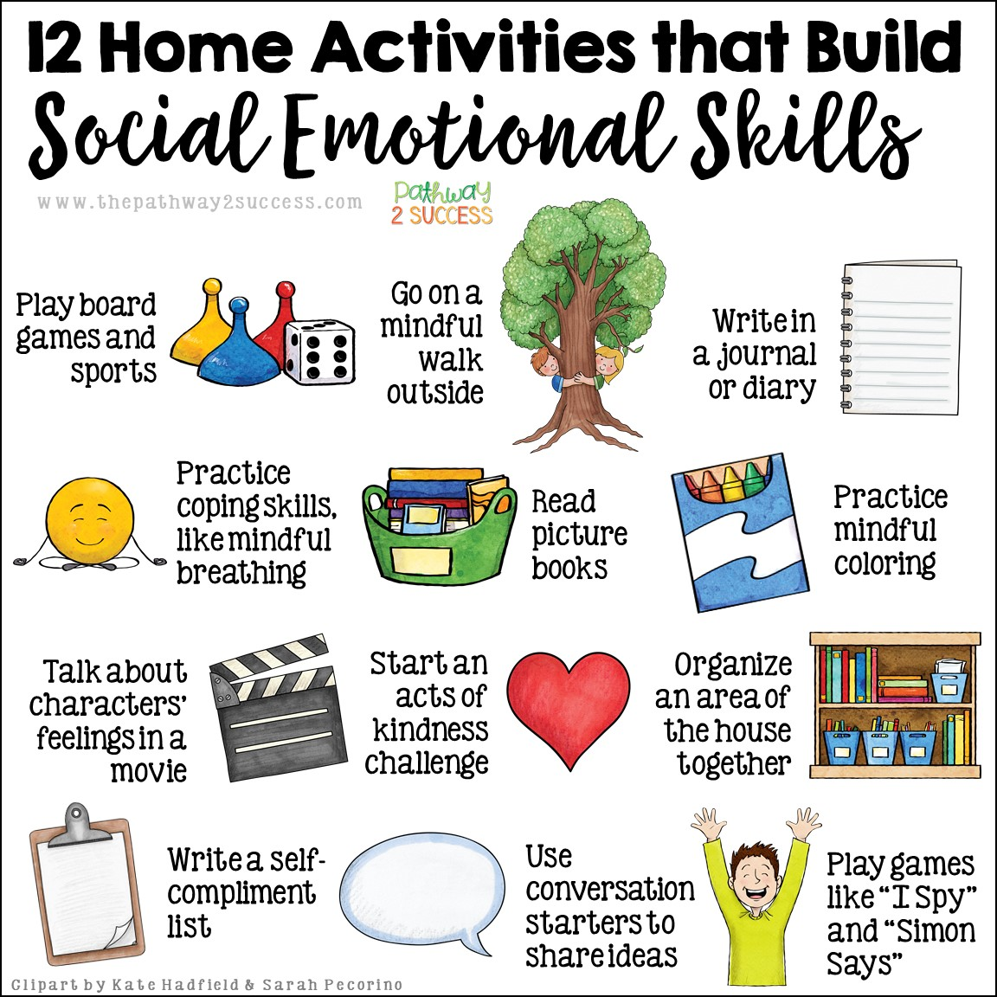
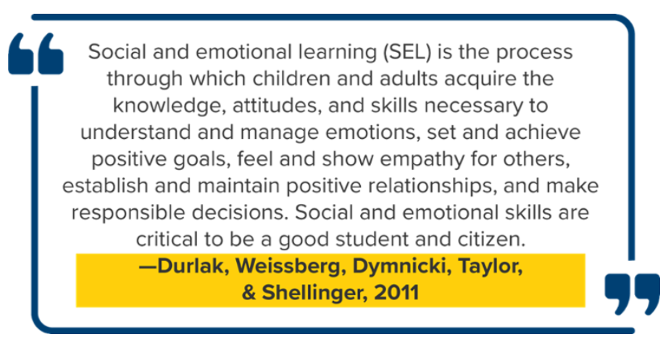
Social Emotional Learning
Mrs. Grossweiler

Slide 17
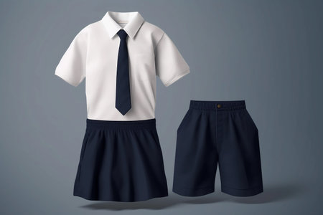
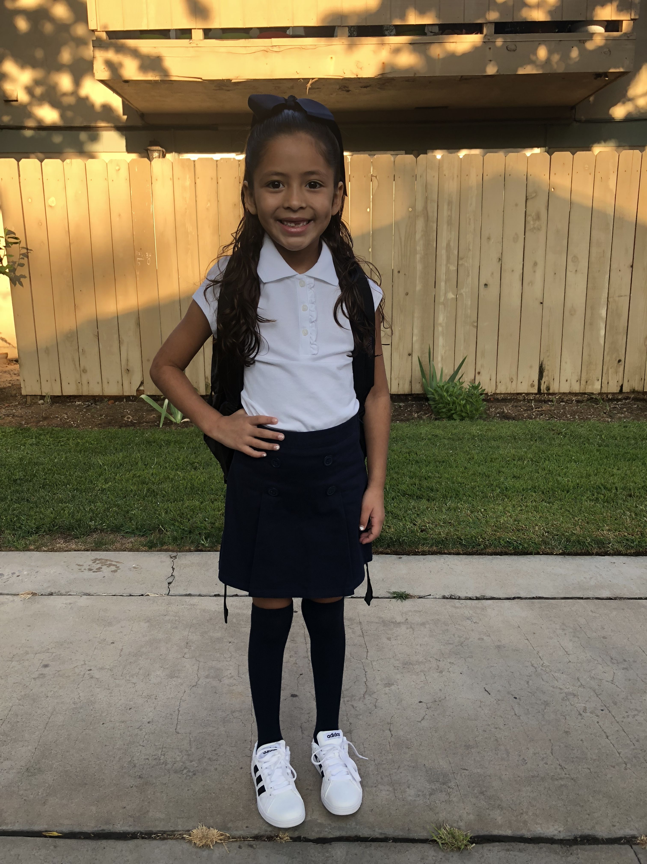
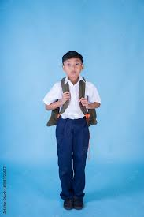
School Uniform
This year we ask that students wear a uniform to school. A white top and dark blue or black pants or skirt are acceptable.
Ms. Ruffino

Slide 19
QUESTIONS Do you have any questions? Click the raise hand button and wait to unmute!

